Slide 1

INFORMATION HANDBOOK
TOGETHER WE ARE STRONGER

Slide 2
CONTENTS PAGE
3
Key Alliance Members
4
What is YPSA?
5
Our Logos Origin Story
7
Our Local Delivery Model
9
Local Delivery Shared Agreement- Student
10
Local Delivery Shared Agreement- Parent/Caregiver
11
Local Delivery Shared Agreement- Home School
12
Local Delivery Shared Agreement- Host School
13
Local Delivery Shared Agreement- Local Delivery Teacher
14
Local Delivery- Assessment & Reporting Guidelines
16
Local Delivery- Costs and Funding
17
Local Delivery- Student Testimonials
19
Vocational Education & training (VET)
22
Flexible Industry Programs Available Through YPSA
23
Certificate III in Early Childhood Education and Care
25
Certificate II Resources and Infrastructure Work Preparation
27
Certificate III In Information Technology
29
Certificate II in Electrotechnology (Career Start)
29
Certificate II in Electrotechnology (Career Start)
31
Flexible Industry Programs- Student Testimonials
33
YPSA Combined Camps
34
Year 10 Exploration Camp
35
Year 11 Activation Camp
36
Year 12 Readiness Camp
37
YPSA Combined Camps- Student Testimonials
FOR MORE INFORMATION
2
CONTACT YOUR HOME SCHOOL SITE LEADERS

Slide 3
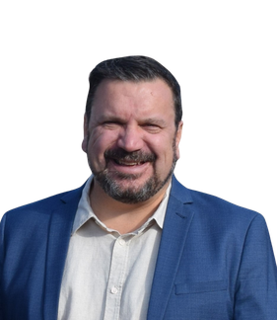
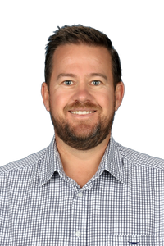
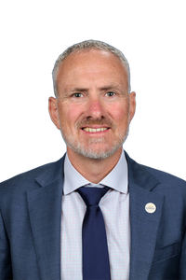
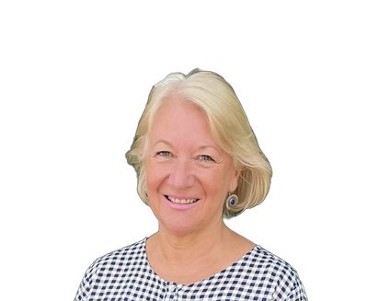
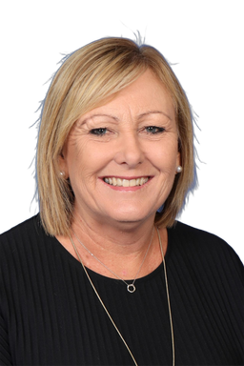
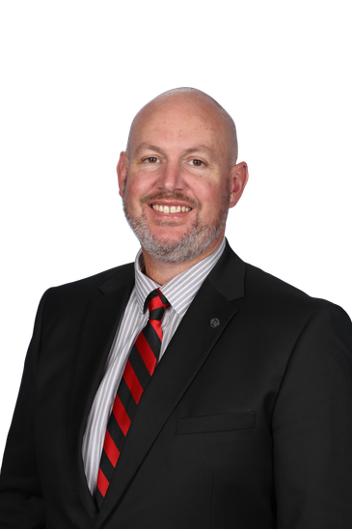
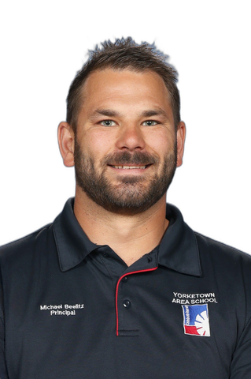
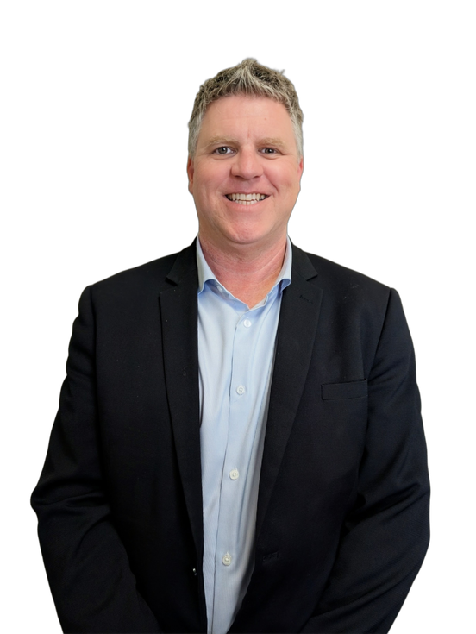
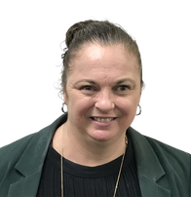
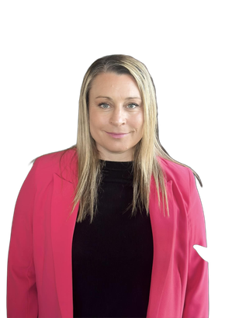
KEY ALLIANCE
MEMBERS
YPSA CHAIRPERSON
Andrew
Dickinson
Minlaton District School Principal
YPSA SITE LEADERS
Scott
Moore
Port Broughton Area School Principal
Alistar
Williams
Kadina Memorial School Principal
Beth
Hector
Moonta Area School
Principal
Margaret
Roads
Ardrossan Area School Principal
Rob
Jeffries
Central Yorke School Principal
Michael
Beelitz
Yorketown Area School Principal
KADINA PORTFOLIO LEADS
David
Cowles
Kadina Portfolio
Education Director
Natasha
Hefford
Kadina Portfolio
Education Lead
Cherie
Beech
Kadina Portfolio
Pathways Advisor
FOR MORE INFORMATION
3
CONTACT YOUR HOME SCHOOL SITE LEADERS
3

Slide 4
WHAT IS YPSA?
The Yorke Peninsula Secondary Alliance (YPSA) was established in 2020 to bring together the seven secondary schools of the Yorke Peninsula: Port Broughton Area School, Kadina Memorial School, Moonta Area School, Ardrossan Area School, Central Yorke School, Minlaton District School, and Yorketown Area School. United by our rural context and deep pride in the Yorke Peninsula, we work together to ensure every young person has access to the learning, pathways, and experiences they deserve, no matter which school they attend or where they live.
Our Purpose
At its heart, YPSA exists to broaden opportunity and strengthen connection. By working collaboratively, we expand subject offerings, streamline systems, and share resources so that students in rural schools can access a curriculum as diverse as any in the state. Our purpose extends beyond traditional subjects to include Flexible Industry Pathways and Vocational Education and Training, ensuring students develop skills that prepare them for further study, training, or employment. Through strong partnerships with local businesses, industries, and communities, YPSA creates opportunities that celebrate equity, nurture local identity, and place student growth at the centre of everything we do.
Our Vision
We are driven by a vision of thriving, future-focused education on the Yorke Peninsula. We see a Local Delivery model that enables students to follow their aspirations regardless of geography, supported by rich opportunities in VET and industry pathways. We aspire to provide immersive experiences that connect young people to industry, careers, and community, helping them gain real insight and develop the knowledge and skills essential for the 21st century. Our vision is one of collaboration, schools, staff, families, and communities working side by side to ensure students feel connected, supported, and inspired to take their next steps with confidence.
Our Role
YPSA plays a pivotal role in coordinating curriculum delivery, facilitating career and training pathways, and supporting collaboration across schools. By pooling resources, aligning with industry, and harnessing the strength of our communities, we prepare young people on the Yorke Peninsula to thrive, in their learning, in their futures, and in the places they call home.
4
TOGETHER WE ARE STRONGER

Slide 5
OUR LOGOS ORIGIN STORY
At the centre of the design is the Yorke Peninsula, a strong reminder that the Yorke Peninsula Secondary Alliance is anchored in place, shared context, and regional pride. Surrounding it is a bold circular structure with seven arcs, representing the seven schools of the Alliance.
The continuous ring forms a unified front, not just connected, but interlocked symbolising that we are stronger because we stand together. Each arc represents people: the students, educators, families, and communities behind each school. Together, they reflect our commitment to collaboration, equity, and shared outcomes.
The three lower motifs symbolise layers of collective growth and shared responsibility, each building upon the other to reflect the core values that define YPSA as a region-wide alliance:
  Foundation Layer: Our regional roots, the strength, history, and resilience of rural education communities working together.
  Middle Layer: Shared learning, schools collaborating, educators sharing expertise, and resources being pooled to broaden opportunity.
  Top Layer: Student potential, the flourishing of diverse pathways and the aspiration for every young person to thrive, no matter their location, demonstrating our ongoing commitment to growth.
This logo is more than a symbol; it embodies the aspirations voiced by YPSA leaders, staff, students, and families. It reflects our dedication to stronger collaboration, consistent curriculum delivery, equitable subject access, and diverse opportunities for every learner. Above all, it communicates that when we share the journey, we multiply the impact for students, staff, and communities across the Yorke Peninsula.
5

Slide 6
OUR LOCAL
DELIVERY MODEL

Slide 7




OUR LOCAL
DELIVERY MODEL
PURPOSE
The Yorke Peninsula Secondary Alliance Local Delivery Model ensures every student across our region can access a broad curriculum, complete their SACE, and be equipped for a successful pathway that leads to further study, training, or employment.
OUR MODEL IN ACTION
Local Delivery is a blended learning approach where students remain at their home school but can access subjects and pathway opportunities at neighbouring schools through online learning, flipped classrooms, face-to-face masterclasses, and shared teaching expertise. This model allows us to maintain comprehensive learning opportunities in our local areas, while keeping students connected to their own communities. With equity at the forefront, it ensures that location or circumstance is never a barrier to accessing high-quality education.
PATHWAYS & POSSIBILITIES
Through Local Delivery, YPSA offers a wide range of Stage 1 and Stage 2 SACE subjects, Flexible Industry Pathways, and VET courses. This gives students access to both core and specialist subjects, maximising their learning opportunities, expanding their career pathways, and strengthening educational outcomes across the region.
OUR COMMITMENT
By sharing resources, teachers, and expertise, YPSA schools are able to create a seamless structure where every young person can access the knowledge, skills, and experiences essential for the 21st century job market. Local Delivery is more than just a way of delivering subjects, it is a commitment to collaboration, community, and ensuring that all Yorke Peninsula students can thrive, no matter their location.
7
TOGETHER WE ARE STRONGER

Slide 8
SUBJECT BROKERING PROCESS
STEP 1
STEP 2
STEP 3
STEP 4
STEP 5
STEP 6
PATHWAY PLANNING, SUBJECT COUNSELLING & SELECTION
HOME SCHOOL
OFFERINGS
YPSA
COLLABORATION
RURAL ALLIANCE COLLABORATION
OPEN ACCESS COLLEGE
ALTERNATIVE SUBJECT OFFERINGS
Students complete subject counselling, selecting subjects by backwards mapping from their post-school pathways, starting with Stage 2 subjects, then Stage 1 subjects.
First, we look to what we can offer on-site at each home school, considering student numbers and available expertise.
If the subject can not be offered at the Home School, we explore what can be offered through YPSA and how we can collaborate, share expertise and numbers to ensure we deliver the subject. During this process we carefully evaluate whether the student is suited to this learning method.
If a subject cannot be offered within the YPSA network, we explore opportunities to connect with other rural alliances across South Australia. This allows us to broaden access and share expertise beyond our region. During this process we carefully evaluate whether the student is suited to this learning method.
If the subject is not available at the home school or YPSA, we consider Open Access College options. During this process we carefully evaluate whether the student is suited to this learning method.
If the subject isn't available via OAC or the student isn't suited for OAC, we carefully consider alternative subjects available at the Home School or across YPSA that still align with the student’s pathway.
8
TOGETHER WE ARE STRONGER

Slide 9

LOCAL DELIVERY SHARED AGREEMENT
STUDENTS
To ensure that Local Delivery is consistent and of high quality across all YPSA schools, we have developed a set of shared expectations. These outline the responsibilities of students, teachers, parents/caregivers, host schools, and home schools. Clear expectations build accountability, strengthen collaboration, and create supportive learning environments that enable all students to achieve the best possible outcomes.
SHARED AGREEMENT:
  Connect to a minimum of two weekly lessons via Microsoft Teams, timetabled at the start of each semester.
  During all online lessons, cameras must remain on at all times, unless prior arrangements have been negotiated.
  Participate in a 1:1 introductory meeting (online or face to face) with their Local Delivery teacher within the first two weeks of each semester to establish shared expectations, discuss learning goals, and review the term or semester overview. Additional meetings may be scheduled as required.
  Participate in all scheduled practical and masterclass sessions. Home schools will negotiate transport arrangements with parents/caregivers.
  Ensure that all correspondence with the delivery teacher is also shared with the home school coordinator.
  Engage fully with the blended model of learning, including Teams lessons, flipped learning, independent study, and in-person sessions.
  Meet all draft and final deadlines and maintain timely communication with teachers and the home school coordinator if challenges arise that may affect progress.
9
TOGETHER WE ARE STRONGER

Slide 10

LOCAL DELIVERY SHARED AGREEMENT
PARENT/CAREGIVERS
To ensure that Local Delivery is consistent and of high quality across all YPSA schools, we have developed a set of shared expectations. These outline the responsibilities of students, teachers, parents/caregivers, host schools, and home schools. Clear expectations build accountability, strengthen collaboration, and create supportive learning environments that enable all students to achieve the best possible outcomes.
SHARED AGREEMENT:
  Support their child’s participation in Local Delivery by ensuring they attend all scheduled online and face-to-face sessions.
  Assist with transport arrangements for practicals or face-to-face lessons if required, in partnership with the home school.
  Maintain open communication with the home school and delivery teacher, responding promptly to correspondence and sharing any concerns.
  Encourage and support their child to meet all draft and final deadlines, seek help when challenges arise, and engage positively with feedback.
  Provide a suitable home environment that supports independent learning, including a device and internet access where possible.
  Celebrate their child’s achievements and work collaboratively with schools to address any concerns or challenges.
10
TOGETHER WE ARE STRONGER

Slide 11

LOCAL DELIVERY SHARED AGREEMENT
HOME SCHOOL
To ensure that Local Delivery is consistent and of high quality across all YPSA schools, we have developed a set of shared expectations. These outline the responsibilities of students, teachers, parents/caregivers, host schools, and home schools. Clear expectations build accountability, strengthen collaboration, and create supportive learning environments that enable all students to achieve the best possible outcomes.
SHARED AGREEMENT:
  Provide students with the required ICT infrastructure, dedicated learning spaces, and technology (laptop, headset, internet access, Daymap support) to engage successfully in Local Delivery.
  Ensure students enrolled in Local Delivery have the skills and dispositions for success, including independent learning and effective communication.
  Assign an on-site mentor to support and guide students, monitor progress, and liaise regularly with Local Delivery teachers.
  Actively supervise students during online lessons and provide a dedicated learning space for Local Delivery sessions.
  Collaborate with host schools to develop and agree on timetabled lessons, finalised by Week 1 of each semester.
  Take responsibility for supporting students and families with any challenges that arise through the Local Delivery system, and work with host schools to put appropriate supports in place.
  Implement clear intervention processes when students do not meet deadlines or expectations, in partnership with the delivery teacher.
11
TOGETHER WE ARE STRONGER

Slide 12

LOCAL DELIVERY SHARED AGREEMENT
HOST SCHOOL
To ensure that Local Delivery is consistent and of high quality across all YPSA schools, we have developed a set of shared expectations. These outline the responsibilities of students, teachers, parents/caregivers, host schools, and home schools. Clear expectations build accountability, strengthen collaboration, and create supportive learning environments that enable all students to achieve the best possible outcomes.
SHARED AGREEMENT:
  Provide the ICT infrastructure and learning spaces required to support Local Delivery.
  Ensure delivery teachers have strong curriculum knowledge and appropriate communication skills, and ICT capability for online and blended teaching.
  Work with home schools to develop and negotiate timetables for virtual and face-to-face lessons, with schedules finalised by Week 1 of each semester.
  Communicate all face-to-face lessons and practical requirements to the home school a minimum of three weeks in advance.
  Take responsibility for providing structured induction and ongoing mentoring to Local Delivery teachers, ensuring they are supported to deliver high-quality teaching and maintain consistency across sites.
  Maintain open and timely communication between the host school coordinator and the home school coordinator at all times.
  Supply quality learning resources (e.g., textbooks, workbooks, digital materials) to students and home schools.
  Celebrate student successes and communicate concerns directly with parents/caregivers, ensuring the home school is included in correspondence.
  Maintain open, transparent communication that builds trust and strong relationships between schools, teachers, families, and students.
  Work collaboratively with the Local Delivery teacher to negotiate appropriate NIT release, recognising the additional time, preparation, and planning required to deliver high-quality learning experiences for students across sites.
  Support the distribution of semester reports.
12
TOGETHER WE ARE STRONGER

Slide 13

LOCAL DELIVERY SHARED AGREEMENT
LOCAL DELIVERY TEACHER
To ensure that Local Delivery is consistent and of high quality across all YPSA schools, we have developed a set of shared expectations. These outline the responsibilities of students, teachers, parents/caregivers, host schools, and home schools. Clear expectations build accountability, strengthen collaboration, and create supportive learning environments that enable all students to achieve the best possible outcomes.
SHARED AGREEMENT:
  Maintain open, transparent communication that builds trust and strong relationships between schools, teachers, families, and students.
  Connect with students through a minimum of two weekly Teams lessons, with all content-based lessons recorded and uploaded to Teams.
  Conduct a 1:1 meeting (online or face to face) with each Local Delivery student within the first two weeks of each semester to establish shared expectations, outline learning goals, and review the term or semester overview. Negotiate delivery platforms (e.g., Teams, Daymap) and communicate the agreed-upon actions and expectations to the student’s Home School.
  Communicate all face-to-face lessons and practical requirements to the home school and host school coordinators a minimum of three weeks in advance.
  Upload all learning materials, tasks, and supports to Teams, ensuring consistent access for students and home schools.
  Provide Learning and Assessment Plans and Semester Overviews to students, families, and home schools by Week 2 of each semester.
  Monitor attendance at online lessons and notify the home school coordinator of any missed sessions.
  Provide both formative and summative feedback to students, parents/caregivers, and the home school coordinator.
  Implement clear intervention processes when deadlines are not met, including timely communication with parents/caregivers and home school staff.
  Negotiate the delivery of practical sessions in a timely manner with all relevant parties, ensuring arrangements are clearly communicated to home schools and families.
  Celebrate student successes and communicate concerns directly with parents/caregivers, ensuring the home school is included in correspondence.
13
TOGETHER WE ARE STRONGER

Slide 14
LOCAL DELIVERY SHARED AGREEMENT
ASSESSMENT & REPORTING GUIDELINES
PURPOSE
Assessment and reporting for Local Delivery subjects across YPSA schools align with the Department for Education guidelines and the SACE Board’s policies and procedures, ensuring fairness, integrity, and consistency across all sites.
These guidelines provide a framework for how student progress and achievement are assessed and communicated. They reflect YPSA’s commitment to equity, collaboration, and high-quality learning outcomes for every student, regardless of their location.
Our Commitment
YPSA schools follow a ‘no surprises’ policy for assessment and reporting.
This means:
  Clear, proactive, and timely communication occurs throughout each semester and year.
  Students, families, and home schools are kept informed of progress, achievements, and areas for improvement.
  Communication includes both written and verbal updates to ensure shared understanding and support.
Teachers are encouraged to celebrate success, communicate concerns early, and work collaboratively with families and coordinators to identify next steps for improvement.
Fairness, Integrity and Consistency
Assessment practices within YPSA schools are guided by the principles of fairness, transparency, and evidence-based decision making.
Teachers will:
  Use agreed assessment practices and shared moderation processes to ensure consistency across sites.
  Reference SACE Performance Standards and Australian Curriculum Achievement Standards where appropriate.
  Make ethical and transparent assessment decisions, based on valid evidence of student learning.
  Use a variety of strategies and tools to respond to diverse learner needs.
14
TOGETHER WE ARE STRONGER

Slide 15
LOCAL DELIVERY SHARED AGREEMENT
ASSESSMENT & REPORTING GUIDELINES
Reporting Framework
Reporting in YPSA schools is an ongoing and purposeful process designed to keep all stakeholders informed. It includes both formal written reports and informal updates through conversations, emails, and meetings where required.
Feedback will focus on:
  What students have achieved so far
  What their next learning steps are
  How teachers, families, and schools can work together to support growth
All reports will use the A+–E- grading scale (referencing SACE Performance Standards) alongside an effort rating to recognise student application and engagement.
Reporting Timeline
To maintain consistency across sites, YPSA schools will follow this reporting rhythm:
Supporting Diverse Learners
For students with an adjusted learning program or a One Plan, assessment and reporting will be modified in consultation with the student, their family, and the home school. This ensures reporting reflects each student’s individual goals, growth, and achievement while maintaining fairness and high expectations. Home Schools will inform Host School of any One Plan needs.
Quality Assurance
To maintain integrity and consistency across YPSA sites, schools will:
  Engage in collaborative moderation to support consistent grading
  Participate in cross-site discussions to align expectations and strengthen professional judgement
  Document and store evidence of learning ethically and securely
Mid-Semester Progress Summary
  Completed by Week 8 each term (or as agreed by YPSA)
  Includes a grade, effort level, overall comment, and an indication where further communication is required
  Sent to families with the home school coordinator CC’d into the communication
End of Semester Report
  Includes a written comment outlining student progress, strengths, challenges, and next learning steps
  Sent to families with the home school coordinator CC’d into the communication
  Ensures all stakeholders share a clear understanding of student achievement and support needs
15
TOGETHER WE ARE STRONGER

Slide 16




LOCAL DELIVERY SHARED AGREEMENT
LOCAL DELIVERY COSTS
AND FUNDING
Delivering subjects through the YPSA Local Delivery Model involves a shared funding arrangement between schools. While families are not required to pay for Local Delivery subjects, it is important to recognise the significant cost and commitment schools make to ensure every student has access to a broad and equitable range of learning opportunities across the Yorke Peninsula.
HOW IT WORKS
  Student enrolment remains with the home school, and subject enrolments are recorded in Schools Online by the end of Week 3 each semester (or as soon as possible in the case of late enrolments).
  The home school contributes a portion of the Student Centred Funding Model (SCFM) to the host school delivering the subject.
  This funding supports the host school in providing qualified teachers, learning materials, and the infrastructure required for high-quality delivery.
COST STRUCTURE
Local Delivery involves a substantial financial contribution from each student’s home school. A portion of the Student Centred Funding Model is transferred to the host school to support the delivery of specialised subjects, resourcing, staffing, and practical components. This represents a significant investment to ensure students can access the subjects and pathways they need, regardless of their location.
WHY IT MATTERS
These shared costs reflect the collective investment of YPSA schools in maintaining equitable access to specialist subjects and qualified teachers across the region. By working together, schools ensure that geography does not limit opportunity, every student can pursue the subjects and pathways that align with their interests and future goals.
16
TOGETHER WE ARE STRONGER

Slide 17


LOCAL DELIVERY
STUDENT TESTIMONIALS
“Local Delivery helped me become more independent, manage my time, and stay accountable. I’m proud I stayed ahead with my work and taught myself new concepts, which has really strengthened my confidence.”
“Local Delivery allowed me to study Psychology and learn how to work online with other schools. It’s built my confidence to connect with students across YPSA, and now when we meet at events, there are always familiar faces.”
“My teacher supported me throughout the course, boosting my confidence. Without Local Delivery I wouldn’t have been able to study Psychology, and I’m proud of the strong results I achieved.”
“Local Delivery helped me become more adaptable and confident, building my design and digital communication skills. I’m proud of the industry-standard work I created, including my Coobowie Progress Association website.”
17
TOGETHER WE ARE STRONGER

Slide 18
OUR VET & FLEXIBLE INDUSTRY PROGRAMS

Slide 19
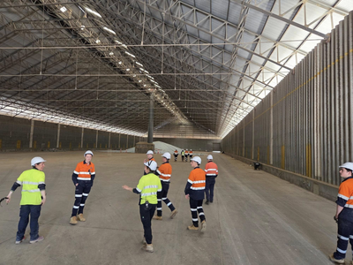
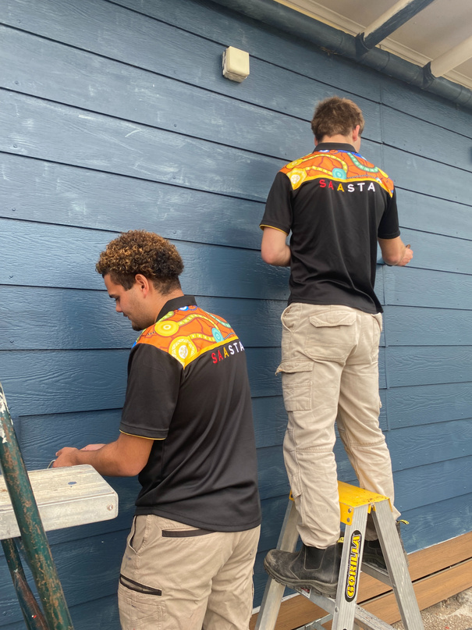
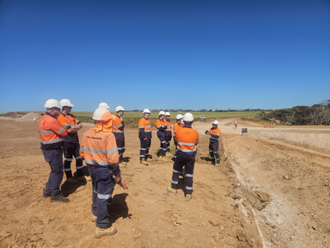
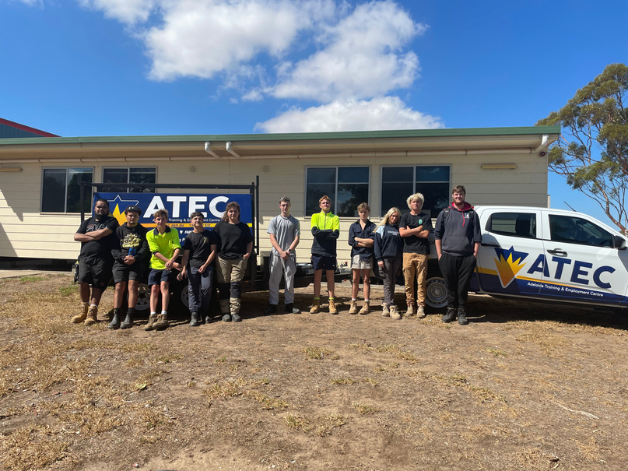
VOCATIONAL EDUCATION & TRAINING (VET)
WHAT IS VET?
Vocational Education and Training (VET) is hands-on learning that contributes directly towards your South Australian Certificate of Education (SACE) and helps you take important steps towards your future career.
Through VET, you can:
  Build technical skills while still at school
  Gain a nationally recognised qualification
  Explore career pathways while developing workplace confidence
VET courses are:
  Accredited by the Australian Skills Quality Authority (ASQA)
  Recognised within the SACE
  Endorsed by industry as suitable for school students
  Delivered by approved Registered Training Organisations (RTOs)
VET gives students the opportunity to combine school, training, and work — helping you develop practical skills that employers value.
WHAT CAN A VET PATHWAY ACHIEVE?
VET helps students gain real-world skills and experience that can lead directly to employment or further study. It supports pathways into:
  Apprenticeships and traineeships
  Higher-level qualifications (Certificate III and above)
  Direct employment in skilled or entry-level positions
  University or TAFE pathways
VET pathways are highly valued by employers and help students build confidence, develop professionalism, and understand how workplaces operate.
UNDERSTANDING VET QUALIFICATION LEVELS
CERTIFICATE II
Builds foundation skills and knowledge to take on routine tasks or prepare for higher-level study.
Certificate III
Equips students with a broad range of technical skills and knowledge for skilled jobs, apprenticeships, or further qualifications.
19
TOGETHER WE ARE STRONGER

Slide 20
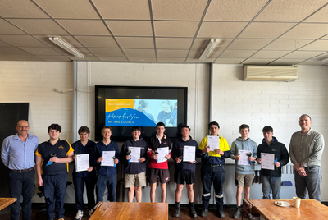
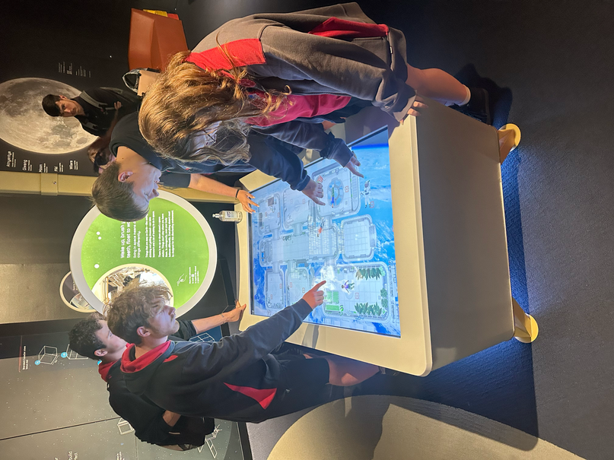
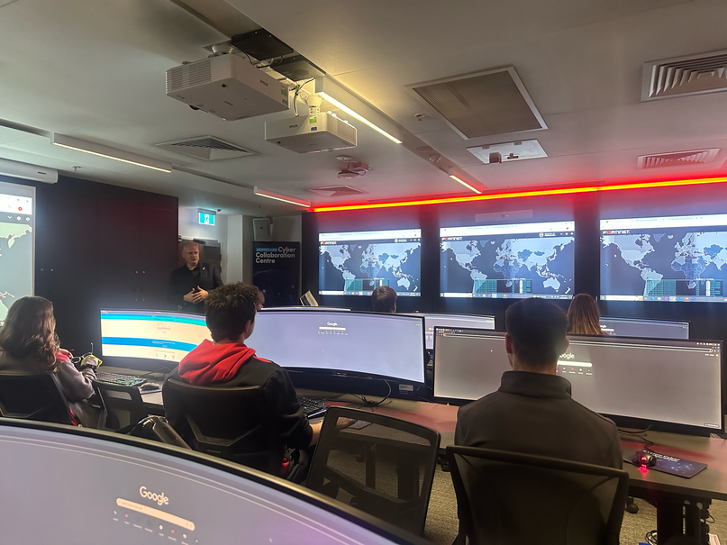
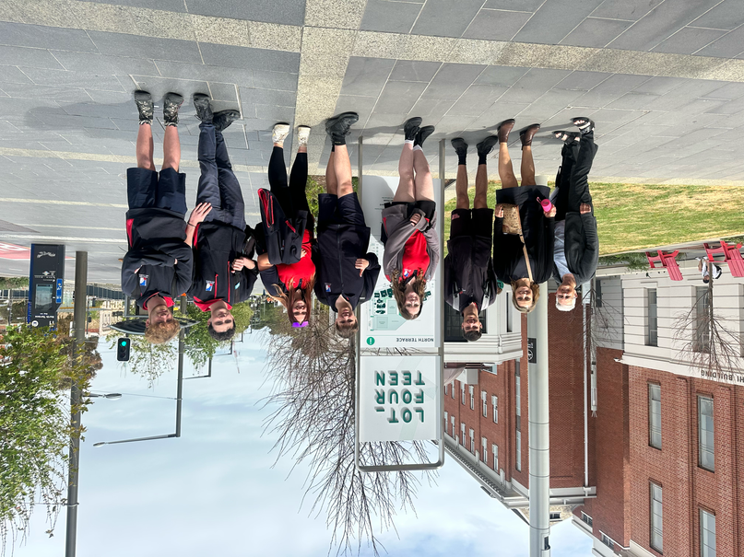
VOCATIONAL EDUCATION & TRAINING (VET)
ACCESSING VET IN YPSA SCHOOLS
Students can access VET in different ways depending on their chosen course:
  At YPSA host schools – many VET programs are delivered onsite across the Alliance.
  At RTO sites – some courses are delivered by external training providers, which may involve travel to a specialist campus.
This flexible model means students can study locally or through partner providers, creating more opportunities to access the training that best fits their goals.
STACKABLE VET
Stackable VET programs are short, entry-level courses (Certificate I, skill sets, or skill clusters) that help you explore different industries and develop foundational workplace skills.
These courses are:
  Ideal for trying out new fields before committing to a qualification
  Designed to help you build “stackable” skills that lead to a Flexible Industry Program (FIP) or higher-level training
  A great way to strengthen employability and career awareness while still at school
FLEXIBLE INDUSTRY PROGRAMS (FIPS)
Flexible Industry Programs (FIPs) offer Certificate II and III qualifications developed in partnership with industry. They combine school learning with practical training and workplace experience.
FIPs:
  Allow students to begin a qualification through customised subjects
  Provide opportunities for school-based apprenticeships or traineeships
  Connect students directly with local and state employer partners
  Lead to entry-level employment, further training, or both
These programs focus on in-demand industries and include:
  Quality career education
  Industry immersion experiences
  Recognised qualifications and direct employer connections
20
TOGETHER WE ARE STRONGER

Slide 21
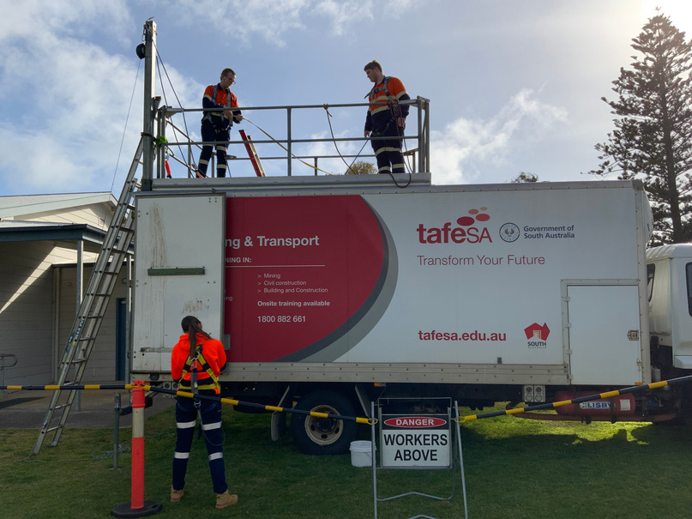
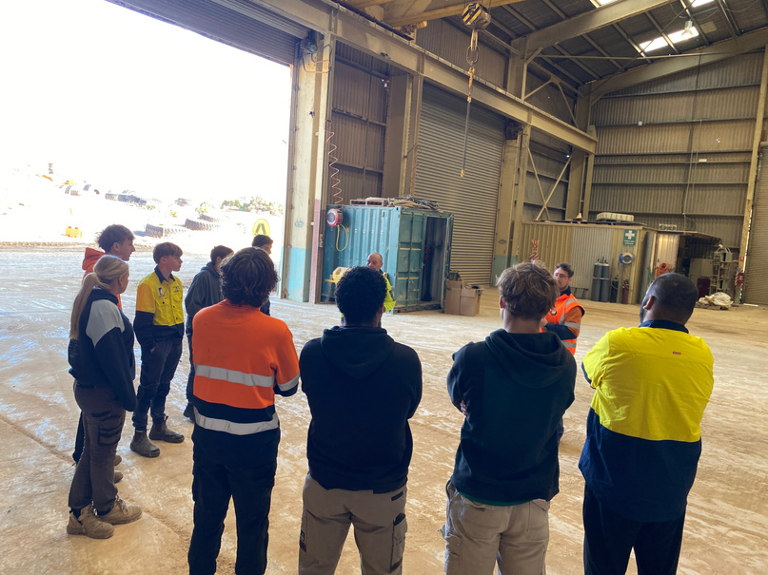
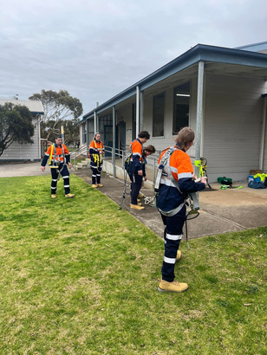
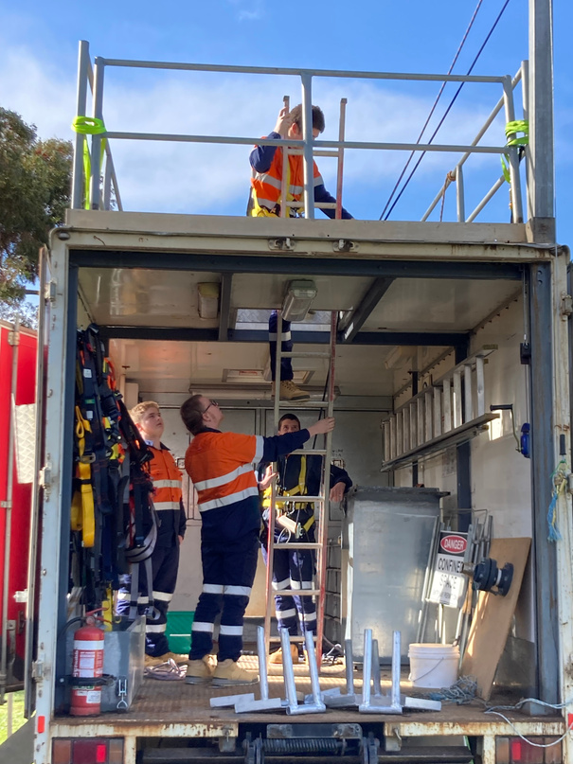
VOCATIONAL EDUCATION & TRAINING (VET)
IS VET THE RIGHT FIT FOR YOU?
VET could be the right choice if you are:
  Keen to explore career pathways and develop practical skills
  Someone who learns best by doing
  Interested in gaining real workplace experience while still at school
  Looking for a head start in a trade, career, or future study
VET pathways in YPSA schools provide real skills, real experiences, and real opportunities. Whether your interests are in early learning, construction, IT, agriculture, or electrical trades, there’s a program designed to help you take the next step toward your future.
Talk to your school’s VET or Careers Leader for more information about the options available through YPSA or other training providers.
21
TOGETHER WE ARE STRONGER

Slide 22





FLEXIBLE INDUSTRY PROGRAMS AVAILABLE THROUGH YPSA
FROM 2026
Certificate III in Early Childhood Education and Care
Certificate II in Resources and Infrastructure Work Preparation
Certificate III in Information Technology
Certificate II in Electrotechnology (Career Start)
CHC30121
RII20120
ICT30120
UEE22020
Kadina Memorial School
Ardrossan Area School
Moonta Area
School
Central Yorke
School
Equals
International
Tafe
SA
Tafe
SA
Equals
International
Up to 155 Stage 2 Credits
Up to 35 Stage 1 Credits
Up to 65 Stage 2 Credits
Up to 60 Stage 1 Credits
FOR MORE INFORMATION VISIT
https://studentpathways.sa.edu.au/vet-pathways
22
TOGETHER WE ARE STRONGER

Slide 23






FLEXIBLE INDUSTRY PROGRAMS
CHC30121
CERTIFICATE III IN EARLY CHILDHOOD EDUCATION AND CARE
SACE Stage 2:
SACE Credits: Up To 155
Suitable for Year 11, 12, of 13 domestic students aged 16 or turning 16 in the enrolment year.
OVERVIEW:
This qualification reflects the role of educators in early childhood education and care who work in regulated children’s education and care services in Australia. They support children’s wellbeing, and development in the context of an approved learning framework. Educators use a range of well developed skills and knowledge using discretion and judgment when carrying out their work in the context of established policies and procedures.
FEES & FUNDING
    Contact Local School For Fee & Funding Information
DURATION & DELIVERY
    1 day per week over 66 weeks.
      Blended options can be negotiated
    160 hours of work placement
    Class Day: Monday
    Start Date: Week 2, Term 1 2026
    Site: Kadina Memorial School
PLACEMENT READINESS REQUIREMENTS
    Working with Children Check
    HTTAID012 Provide First Aid Certificate
    Child Safe Environment Training Certificate
    EQUALS Polo Shirt
    Current Flu Vaccination
    At least 1 Covid-19 Vaccination
Study Units
Core Units
CHCECE030 Support inclusion and diversity
CHCECE031 Support children’s health, safety and wellbeing
CHCECE032 Nurture babies and toddlers
CHCECE033 Develop positive and respectful relationships with children
CHCECE034 Use an approved learning framework to guide practice
CHCECE035 Support the holistic learning and development of children
CHCECE036 Provide experiences to support children’s play and learning
CHCECE037 Support children to connect with the natural environment
CHCECE038 Observe children to inform practice
CHCECE054 Encourage understanding of Aboriginal and/or Torres Strait Islander peoples’ cultures
CHCECE056 Work effectively in children’s education and care
CHCRPT001 Identify and respond to children and young people at risk
HLTAID012 Provide First Aid in an education and care setting
HLTWHS001 Participate in workplace health and safety
Elective Units
CHCDIV001 Work with diverse people
CHCPRP003 Reflect on and improve own professional practice
* Listed competencies are subject to change without notice
FOR MORE INFORMATION
CONTACT KADINA MEMORIAL SCHOOL
(08) 8821 0100
dl.0778.info@schools.sa.edu.au
23
RTO: 41026
TOGETHER WE ARE STRONGER

Slide 24

SEE WHAT IT’S LIKE TO BUILD A CAREER IN
EARLY CHILDHOOD AND EDUCATION
Care for young children and guide their early learning by choosing a pathway in early childhood. You could work in preschools, early childhood services or classrooms. You’ll need a passion for supporting young children, patience, creativity, the ability to problem-solve and plenty of energy.
For More Information Visit:
https://studentpathways.sa.edu.au/vet-pathways
STUDY VET WHILE YOU COMPLETE THE SACE
CHC30121 CERTIFICATE III IN EARLY CHILDHOOD EDUCATION AND CARE
WORK IN YOUR CAREER
Use your VET Qualification to work as...
  Early Childhood Educator
  Outside School Hours Care Educator
  School Services Officer
  Educator Assistant
  Teaching Aide
  Day Care Assistant
FURTHER YOUR CAREER WITH VET
Continue your studies with one of the following:
  CHC40221 Certificate IV in School Based Education Support
  CHC50121 Diploma of Early Childhood Education and Care*
To work as:
  Eary Childhood Team Leader
  Early Childhood Assistant Director
  Early Childhood Director
  Outside School Hours Director
FURTHER YOUR CAREER WITH UNIVERSITY
University study in early childhood can lead to employment as:
  Early Childhood (Primary School) Teacher
  Education Leader
  Assistant Director
  Director
  Primary School Teacher
  Middle School Teacher
  Secondary School Teacher
  Special Education Teacher
  Principal
  Social Worker
  Speech Pathologist
  Occupational Therapist
FOR MORE INFORMATION
CONTACT KADINA MEMORIAL SCHOOL
(08) 8821 0100
dl.0778.info@schools.sa.edu.au
24
RTO: 41026
TOGETHER WE ARE STRONGER

Slide 25



FLEXIBLE INDUSTRY PROGRAMS
RII20120
CERTIFICATE II RESOURCES AND INFRASTRUCTURE WORK PREPARATION
SACE Stage 1:
SACE Credits: Up To 35
Suitable for Year 11, 12, of 13 domestic students aged 16 or turning 16 in the enrolment year.
OVERVIEW:
This pre-vocational qualification provides the practical skills and knowledge needed to start a career in the resources and infrastructure industries, including mining, drilling, petroleum exploration, and construction. Students will develop essential safety, teamwork, and employability skills while gaining hands-on experience through industry mentoring, field trips, and immersion experiences.
Delivered in partnership with local and statewide industry partners, this qualification contributes Stage 1 credits towards the SACE and offers a strong pathway into further training, apprenticeships, or employment.
FEES & FUNDING
    Contact Local School For Fee & Funding Information
DURATION & DELIVERY
    7x 3 Day Blocks (Tuesday-Thursday)
SITE
    Ardrossan Area School
WHAT YOU WILL NEED?
    PPE TO BE SUPPLIED BY STUDENTS
      Long Sleeve High VIS Shirt
      Long Work Pnats
      Steel Cap Boots
Study Units (Nominal Hours: 196)
Core Units
RIICOM201E Communicate in the workplace
RIIENV201E Identify and assess environmental and heritage concerns
RIIRS2021E Conduct local risk control
RIIWHS202E Work safely and follow WHS policies and procedures
RIISAM202E Isolate and access plant
RIISAM201E Handle resources and infrastructure materials and safely dispose of nontoxic materials
RIICCM201E Carry out measurements and calculations
RIIWHS202E Enter and work in confined spaces
RIIWHS204E Work safely at heights
* Listed competencies are subject to change without notice
FOR MORE INFORMATION
CONTACT ARDROSSAN AREA SCHOOL
(08) 8837 3025
dl.0732.info@schools.sa.edu.au
25
RTO: 41026
TOGETHER WE ARE STRONGER

Slide 26


SEE WHAT IT’S LIKE TO BUILD A CAREER IN
CIVIL CONSTRUCTION & INFRASTRUCTURE
Civil construction involves building things that a community needs, like roads, hospitals, waterways and airports. Daily activities include carrying out manual excavations, spreading and compacting materials, basic levelling, repairing potholes and putting traffic management plans in place. You need to enjoy working outdoors, be fit, and have great communication and problem-solving skills. A driver’s licence is usually required.
For More Information Visit:
https://studentpathways.sa.edu.au/vet-pathways
JOB PATHWAYS
CAREERS
  Civil Construction and Maintenance Worker
  Civil Construction Plant Operator
  Open Cut Miner
  Small Mine Operator
  Drilling Assistant
  Process Plant Operator
  Civil Construction and Maintenance Worker – Operations
  Civil Construction and Maintenance Worker – Supervisor
  Open Cut Mine Supervisor
  Quarry Supervisor
TRADE PATHWAYS
START HERE
RII40720 Certificate IV in Civil Construction
RII40120 Certificate
IV in Surface Extraction Operations
Certificate II in Resources and Infrastructure Work Preparation
FOR MORE INFORMATION
CONTACT ARDROSSAN AREA SCHOOL
(08) 8837 3025
dl.0732.info@schools.sa.edu.au
26
RTO: 41026
TOGETHER WE ARE STRONGER

Slide 27


FLEXIBLE INDUSTRY PROGRAMS
RII20120
CERTIFICATE III IN INFORMATION TECHNOLOGY
SACE Stage 2:
SACE Credits: Up To 65
OVERVIEW:
Develop technical skills in software application, cyber awareness, digital media, generalist IT support services, networking, programming, systems and web development. Throughout this course you will also build industry essential skills that are transferable across multiple sectors. Skills such as critical thinking, problem solving, presenting and customer service to support a range of technologies, processes, policies and clients.
FEES & FUNDING
    Contact Local School For Fee & Funding Information
DURATION & DELIVERY
    1x Day Per Week Over 18 Months Virtually Delivered
SITE
    Moonta Area School
WHAT YOU WILL NEED?
    ALL RESOURCES REQUIRED FOR THE COURSE WILL BE PROVIDED FOR USE WHILST ENROLLED, INCLUDING A LAPTOP AND HEADSET.
Study Units (Nominal Hours: 480)
Core Units
ICTPRG302 Apply introductory programming techniques
BSBCRT301 Develop and extend critical and creative thinking skills
ICTICT313 Identify IP, ethics and privacy policies in ICT environments
ICTSAS305 Provide ICT advice to clients
BSBXCS303 Securely manage personally identifiable information and workplace information
BSBXTW301 Work in a team
Electives
ICTWEB304 Build simple web pages
BSBXCS302 Identify and report online security threat
ICTNWK311 Install and test network protocols
ICTICT214 Operate application software packages
ICTSA308 Run standard diagnostic tests
ICTICT312 Use advanced features of applications
* Listed competencies are subject to change without notice
FOR MORE INFORMATION
CONTACT MOONTA AREA SCHOOL
(08) 8825 2088
dl.1488.info@schools.sa.edu.au
27
RTO: 41026
TOGETHER WE ARE STRONGER

Slide 28

SEE WHAT IT’S LIKE TO BUILD A CAREER IN
INFORMATION TECHNOLOGY
CThe Information Technology and Cyber Security industries are critical to the functioning of today’s digital world, supporting everything from business operations to personal communications. IT involves the design, development, and maintenance of computer systems and software, while Cyber Security focuses on protecting data, networks, and systems from digital threats.
For More Information Visit:
https://studentpathways.sa.edu.au/vet-pathways
JOB PATHWAYS
CAREERS
  Help Desk Officer
  ICT Operations Support
  ICT User Support
  PC Support Technician
  Technical Support Officer
  Network Support Officer
  Software Developer / Engineer
  Network Administrator / Engineer
  Cyber Security Analyst
  Systems Administrator
  Web Developer / Digital Media Specialist
  ICT Consultant / Business Analyst
  Data Analyst
FURTHER EDUCATION
Certificate IV in Information Technology
Diploma of Information Technology
Bachelor of Information Technology
Bachelor of Computer Science
START HERE
Certificate III in Information Technology
FOR MORE INFORMATION
CONTACT MOONTA AREA SCHOOL
(08) 8825 2088
dl.1488.info@schools.sa.edu.au
28
RTO: 41026
TOGETHER WE ARE STRONGER

Slide 29


FLEXIBLE INDUSTRY PROGRAMS
UEE22020
CERTIFICATE II IN ELECTROTECHNOLOGY (CAREER START)
SACE Stage 1:
SACE Credits: Up To 60
OVERVIEW:
This pre-vocational qualification covers essential competencies for work entry, with a strong focus on safety and basic skills competency, use of tools and knowledge to work across the discipline and within a range of industrial, commercial and residential contexts. You will learn the fundamental electrical skills and knowledge you need to be work ready and have a pathway towards an electrical apprenticeship. Designed in collaboration with local industry, EQUALS' pre?vocational training in electrotechnology is considered a valuable pre-apprenticeship qualification.
FEES & FUNDING
    Contact Local School For Fee & Funding Information
DURATION & DELIVERY
    1 day per week over 36 weeks
    Tuesdays 9 am to 3 pm
SITE
  Central Yorke School
WHAT YOU WILL NEED?
PERSONAL PROTECTIVE EQUIPMENT (PPE
    EQUALS will provide shirt, gloves & safety glasses
    You will need to purchase and wear your own safety boots and long pants for practical sessions
Study Units (Nominal Hours: 496)
Core Units
CPCCWHS1001- Prepare to work safely in the construction industry
UEECD0007- Apply work health and safety regulations, codes and practices in the workplace
UEECD0009- Carry out routine work activities in an energy sector environment*
UEECD0021- Identify and select components, accessories and materials for energy sector work activities*
UEECD0038- Provide solutions and report on routine electrotechnology problems
UEECD0046- Solve problems in single path circuits*
UEECD0052- Use routine equipment/plant/technologies in an energy sector environment*
UEERE0021- Provide basic sustainable energy solutions for energy reduction in residential premises
Elective Units
UEECO0002- Maintain documentation
UEEAS0004- Select electronic components for assembly*
UEECD0019- Fabricate, assemble and dismantle utilities industry components*
UEECD0020- Fix and secure electrotechnology equipment*
UEECD0034- Produce routine tools/devices for carrying out energy sector work activities*
* Listed competencies are subject to change without notice
FOR MORE INFORMATION
CONTACT CENTRAL YORKE SCHOOL
(08) 8832 2613
dl.0761.info@schools.sa.edu.au
29
RTO: 41026
TOGETHER WE ARE STRONGER

Slide 30

SEE WHAT IT’S LIKE TO BUILD A CAREER IN
ELECTROTECHNOLOGY
Power up your future with a pathway in electrical, refrigeration and air-conditioning, power distribution, instrumentation, or electronics and communications. This field involves installing, repairing, and maintaining equipment and systems in homes, businesses, and industries. Success in electrotechnology requires strong skills in mathematics, problem-solving, attention to detail, and customer service. A driver’s licence is usually required to support employment in this pathway.
For More Information Visit:
https://studentpathways.sa.edu.au/vet-pathways
JOB PATHWAYS
CAREERS
Renewable Energy
Electrical Engineering Refrigeration
Maintenance
Commercial Domestic Industrial
High Voltage
Education
IT/Security
Oil and Gas Mining Regulatory
Communications
Project Management
Design Engineering
START HERE
TRADE PATHWAYS
Certificate II in Electrotechnology (Career Start)
Certificate III in Electrotechnology Electrician
FOR MORE INFORMATION
CONTACT CENTRAL YORKE SCHOOL
(08) 8832 2613
dl.0761.info@schools.sa.edu.au
30
RTO: 41026
TOGETHER WE ARE STRONGER

Slide 31
FLEXIBLE INDUSTRY PATHWAYS
STUDENT TESTIMONIALS
“The highlight of my Flexible Industry Pathway has been earning my certificate and building strong hands-on skills. I’m proud of what I’ve learnt, and have now been accepted into a School Based Apprenticeship.”
“The skills I’ve developed have been the most rewarding part of my FIP. I’m proud of the networking, programming, and cyber security skills I’ve learnt, and I plan to continue building my qualifications and start a career in IT.”
“Learning from professionals and gaining future-ready skills has been rewarding. I’m proud of the welding techniques, teamwork skills, and qualifications I’ve gained, and I’ll use them to help secure an apprenticeship.”
“Electrotechnology at Central Yorke has been awesome. We had a great mix of theory and hands-on practical work, and I loved connecting everything and seeing how it works in real life.”
“The Electrotechnology FIP has helped me explore pathways to becoming an electrician. I’m looking forward to doing more work experience, and I already have time lined up with a local electrician to build my skills.”
“The maths was easier than I expected, and General Maths helped a lot. I liked meeting students from other schools and learning in a new environment. Work experience was a highlight, I learnt so much about the industry.”
31
TOGETHER WE ARE STRONGER

Slide 32
YPSA COMBINED CAMPS

Slide 33






YPSA COMBINED CAMPS
From exploration to activation to readiness, YPSA Camps are the stepping stones that connect students, strengthen communities, and build confidence for the future.
Our YPSA Camps are designed as a connected journey that supports students from exploration to readiness. Each experience builds on the one before it, developing confidence, independence, and clarity about future pathways. Through these shared experiences, students form lasting relationships with peers and staff across schools, making future opportunities such as Local Delivery, VET, and FIPs more accessible and less daunting.
This carefully sequenced model ensures that as students grow, so too does their sense of belonging, purpose, and preparedness for life beyond school.
Year 10
YEAR 10 EXPLORATION CAMP
Students begin exploring who they are and what possibilities exist beyond school by building independence, confidence, and community connections.
Year 11
YEAR 11 ACTIVATION CAMP
Students actively shape their future pathways by connecting with industry, exploring post-school options, and developing leadership and decision-making skills.
Year 12
YEAR 10 READINESS CAMP
Students consolidate their skills, reflect on their journey, and prepare to confidently transition into further study, training, or employment.
33
TOGETHER WE ARE STRONGER

Slide 34
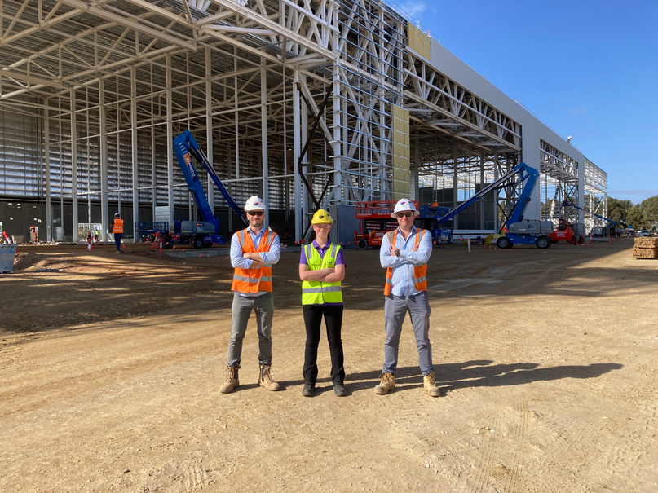
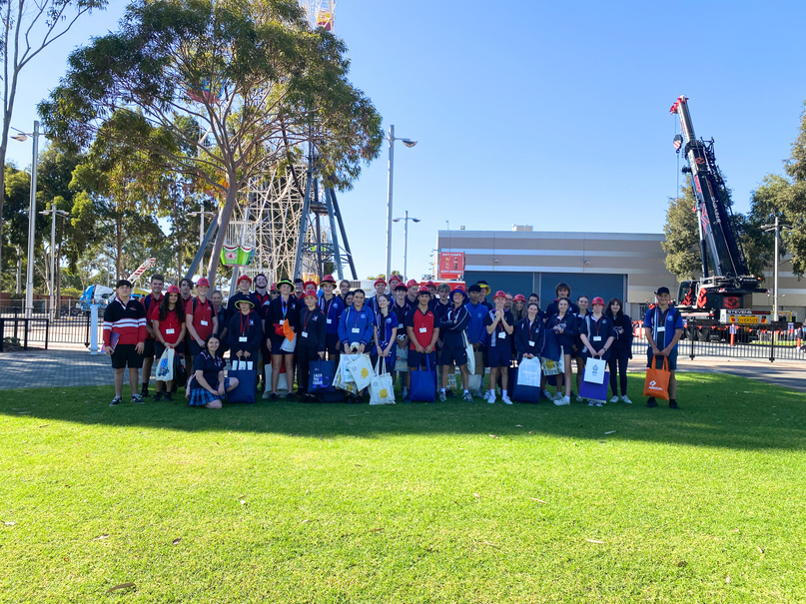
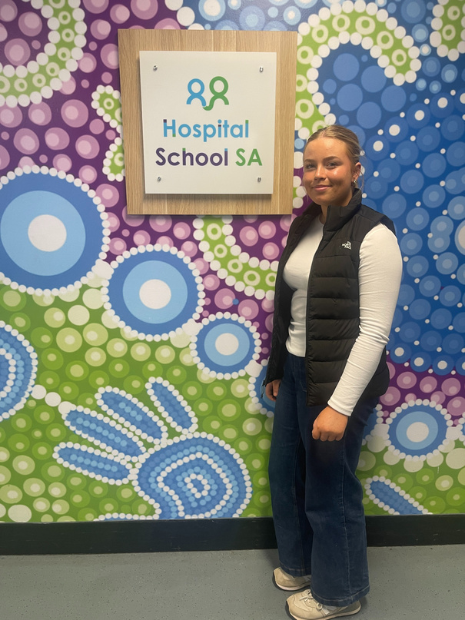
YEAR 10 EXPLORATION CAMP
It’s about more than just work experience, it’s about exploring what’s possible.
The Year 10 Combined Exploration Camp is where curiosity meets opportunity. Co-designed to spark interest in future pathways, this experience gives students a real-world taste of life beyond the Yorke Peninsula while helping them build independence, confidence, and practical skills.
All Year 10 students travel together by chartered bus to Adelaide, where they complete three days of hands-on, individualised work experience with host employers across a variety of industries. Each student undertakes a personalised placement aligned with their interests and career goals, allowing them to explore potential pathways in a meaningful and authentic way.
Whether working in education, trades, healthcare, retail, or technology, students gain valuable insights into career possibilities while developing teamwork, communication, and problem-solving skills.
Beyond the workplace, this camp helps students navigate city life, learning how to use public transport, manage time, and adapt to new environments. These experiences build self-reliance and resilience, empowering students to take the first steps towards their future with confidence.
Work placements are arranged and supported by teachers from each YPSA school, ensuring that every student’s experience is personalised, purposeful, and well supported. The connections formed during this camp, with peers, teachers, and employers, create a foundation for future opportunities in Local Delivery, Flexible Industry Pathways (FIPs), School Based Apprenticeships and VET.
34
TOGETHER WE ARE STRONGER

Slide 35
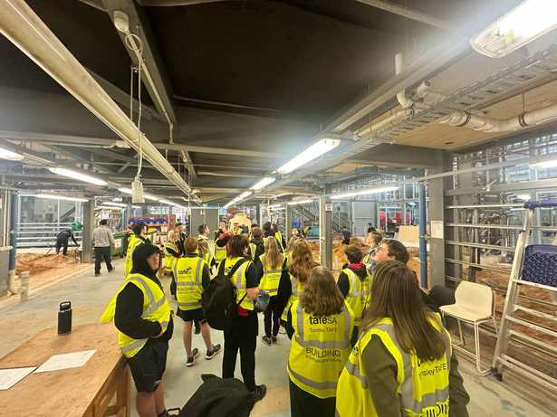
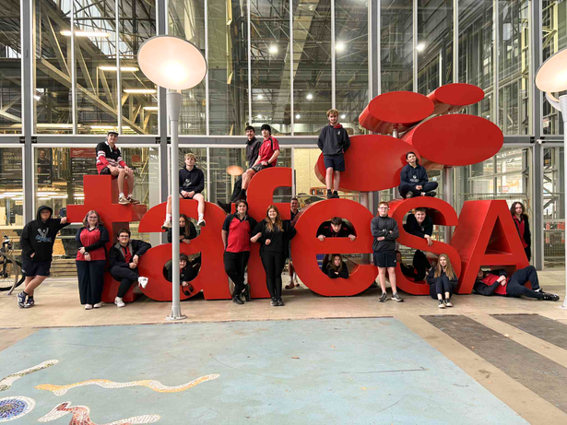
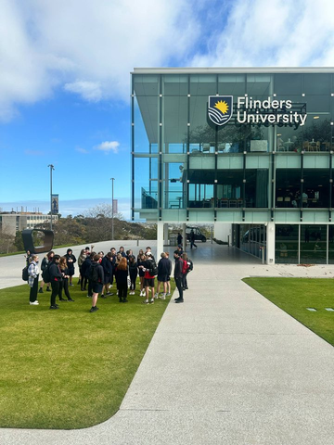
YEAR 11 ACTIVATION CAMP
Bridging exploration and action, empowering students to take the next step toward their future.
Building on the exploration and independence developed during the Year 10 Combined Exploration Camp, the Year 11 Combined Activation Camp marks the next step in the journey from exploration to activation. This camp empowers students to turn their growing self-awareness into action, helping them make informed choices about their future pathways.
Designed to be responsive to each cohort’s interests and needs, the camp evolves each year to ensure relevance and impact. If a large number of students express interest in specific fields, such as allied health, education, trades, or technology tailored experiences and industry visits are woven into the program. This personalised approach ensures every student engages in experiences that are meaningful and connected to their aspirations.
Throughout the camp, students visit TAFE and university campuses, connect with industry professionals, and participate in hands-on workshops that build confidence, direction, and career readiness.
They are supported to:
  Explore post-school options including TAFE, university, employment, and the Australian Defence Force.
  Discover industries and pathways that align with their interests, values, and strengths.
  Understand the steps needed in Year 11 and 12 to achieve their goals.
  Build connections with peers, mentors, and educators from across the Yorke Peninsula.
The Pathways Camp is a purposeful and energising experience that bridges exploration and action. It helps students see the link between what they are learning now and where they are headed next, building confidence and connection across schools, industries, and futures.
35
TOGETHER WE ARE STRONGER

Slide 36
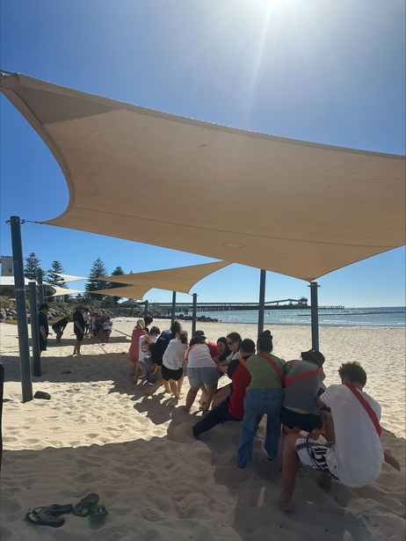
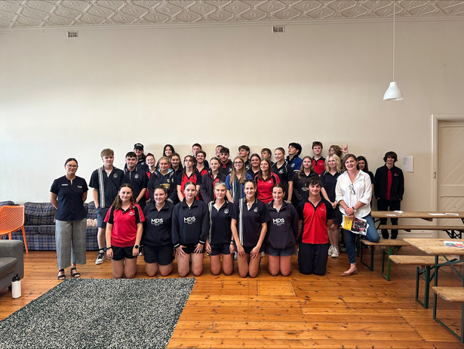
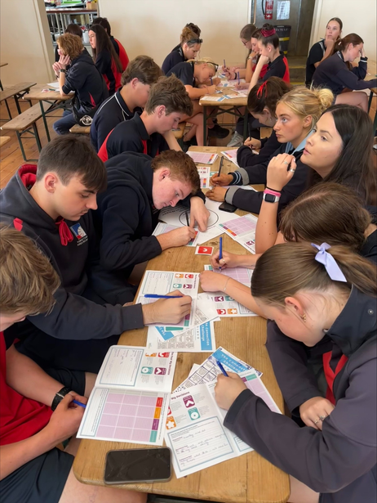
YEAR 12 READINESS CAMP
From activation to readiness, preparing for success, connection, and life beyond school.
The Year 12 Combined Readiness Camp marks the final stage in the YPSA journey, the transition from activation to readiness. After exploring possibilities in Year 10 and activating their pathways in Year 11, students now come together to prepare for their final year of schooling with purpose, confidence, and connection.
Held at the beginning of the school year, this two-day retreat is designed to help students start Year 12 on the right foot. Through a balance of inspiring workshops, guest speakers, and team-based activities, students build motivation, set goals, and develop strategies to manage the challenges and opportunities that come with their final year.
Beyond academics, the retreat focuses on wellbeing, mindset, and connection, reminding students that success in Year 12 is not just about hard work, but also about balance, resilience, and support.
It’s also a chance to reconnect with friends and peers from previous YPSA camps and events, and to connect with students they may be working alongside in Local Delivery subjects or Flexible Industry Pathways (FIPs). These shared experiences strengthen relationships, foster collaboration, and build the confidence to take on new challenges together.
Together, students begin planning for the much-anticipated SYP Combined Formal, celebrating how far they’ve come and the connections they’ve built along the way.
The Year 12 Retreat sets the tone for a successful and memorable final year,a year grounded in focus, supported by friendship, and filled with readiness for what comes next.
36
TOGETHER WE ARE STRONGER

Slide 37
COMBINED CAMPS
STUDENT TESTIMONIALS
“The beach activities were a highlight, and camp helped me connect with people my age. I realised how important it is to make friendships that support you along the way.”
“Meeting new students and building connections was a highlight. The group activities boosted my confidence, and I learnt how valuable it is to step outside my comfort zone.”
“Meeting students from other schools was a highlight, and I learnt a lot about the pathways we explored. It helped me feel more informed about my future.”
“I enjoyed making new connections and gaining independence. The activities, like the AFL game, helped everyone feel comfortable talking, and the work experience prepared me for future work and getting around the city.”
“I loved bonding with students from other schools. Experiencing the city and joining in activities helped me feel more confident, and I realised the city isn’t as scary as I thought.”
“I enjoyed connecting with students from other schools, work experience, the Amazing Race, and campus visits. The camps helped me gain confidence in new environments and understand my future pathways more clearly.”
37
TOGETHER WE ARE STRONGER

Slide 38
FOR MORE INFORMATION
CONTACT YOUR HOME SCHOOL SITE LEADERS

